Slide 1
SL Physics multiple choice questions
May 2012 TZ1

Slide 2
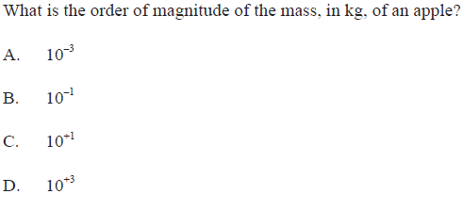
Mass of an apple

Slide 3
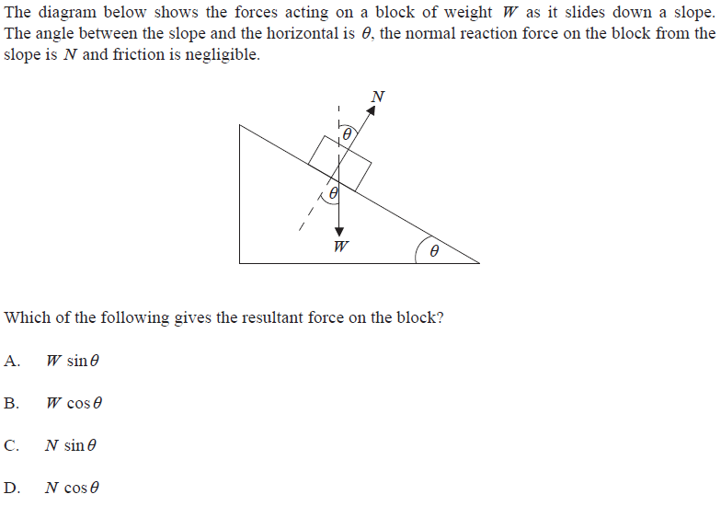
Resolving forces

Slide 4
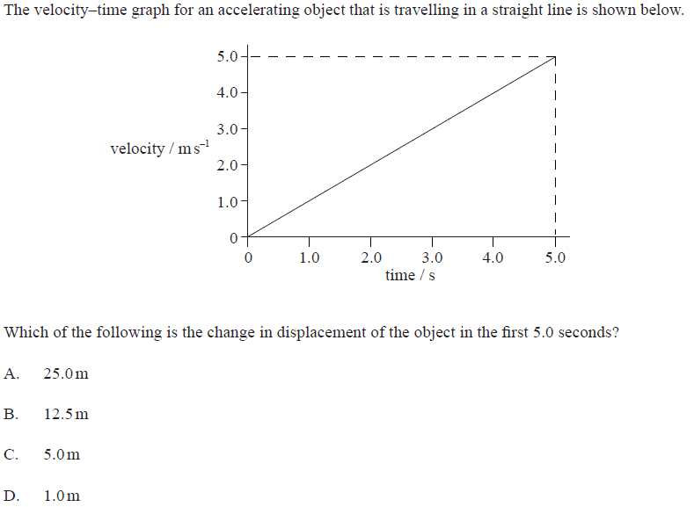
Change in displacement

Slide 5
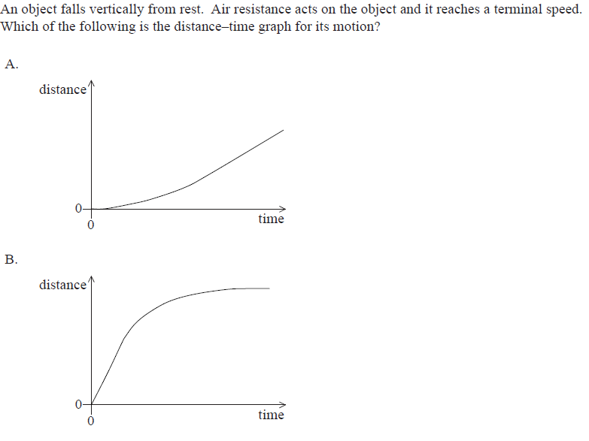
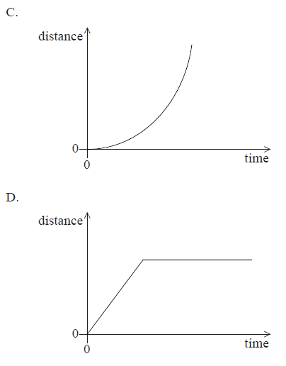
Terminal Speed

Slide 6
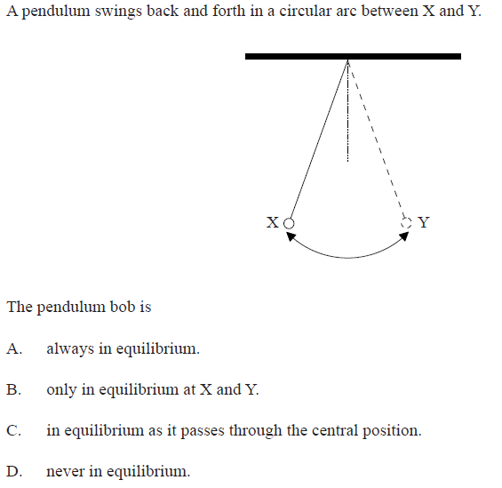
Equilibrium?

Slide 7
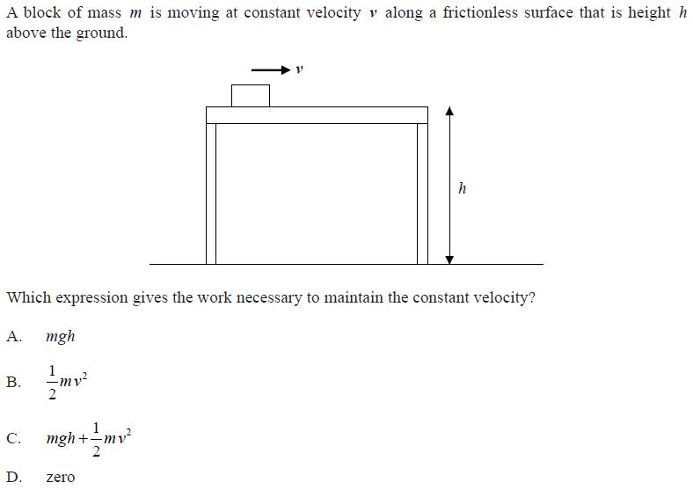
Work

Slide 8
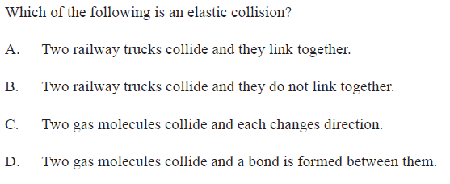
Elastic collision

Slide 9

Centripetal force

Slide 10

Energy type

Slide 11
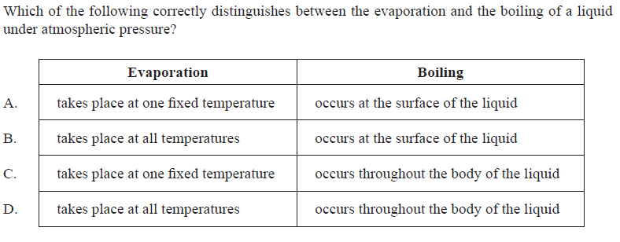
Evaporation and Boiling

Slide 12

Temperature and E_{k}

Slide 13
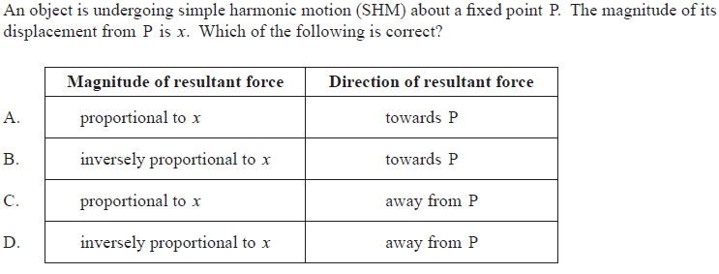
SHM

Slide 14

SHM Energy

Slide 15

Electro-magnetic spectrum

Slide 16
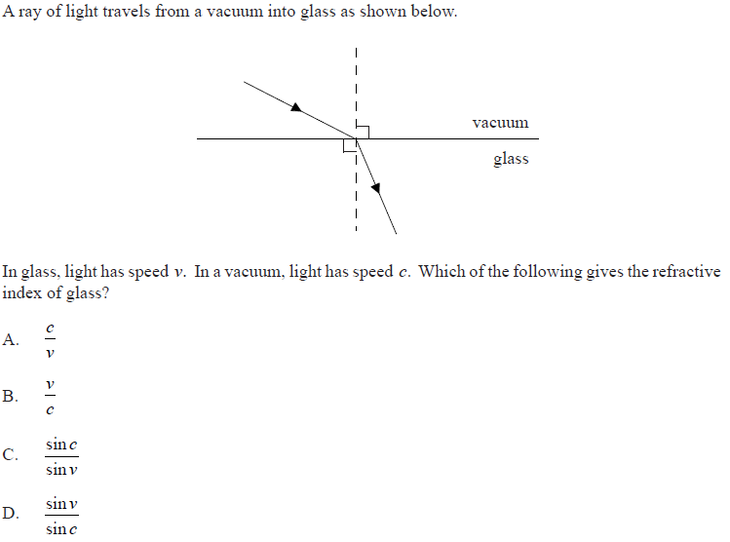
Refractive index

Slide 17
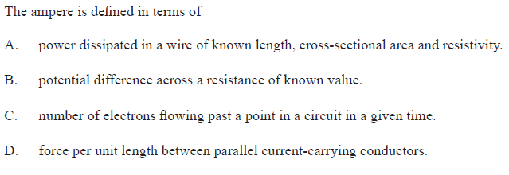
The ampere

Slide 18

Internal resistance

Slide 19
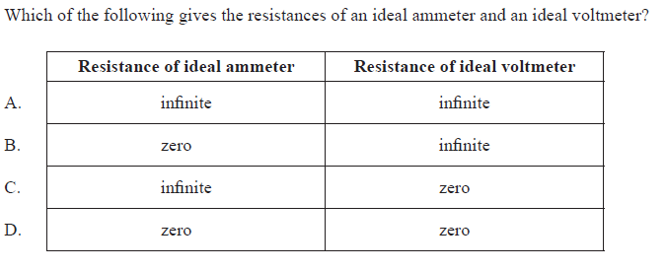
Ideal meters

Slide 20
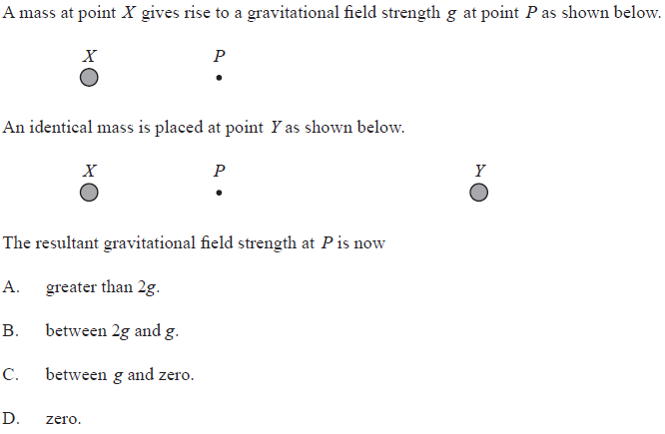
Gravitational Field

Slide 21
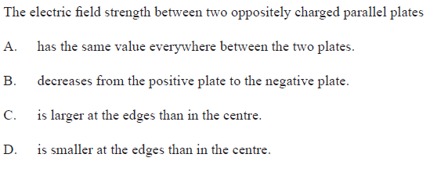
Electric Field

Slide 22
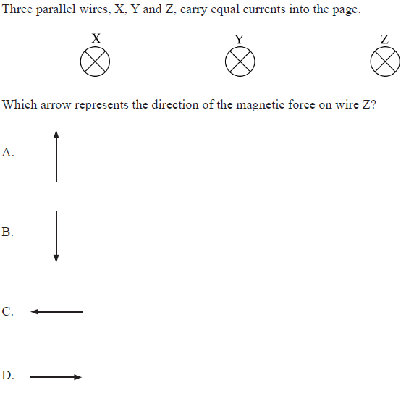
Current carrying wires

Slide 23

Alpha, Beta, Gamma

Slide 24
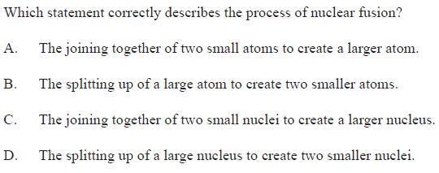
Fusion

Slide 25
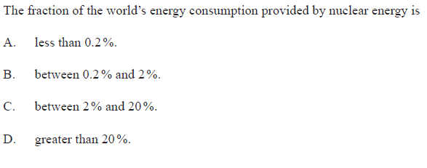
Nuclear Energy

Slide 26
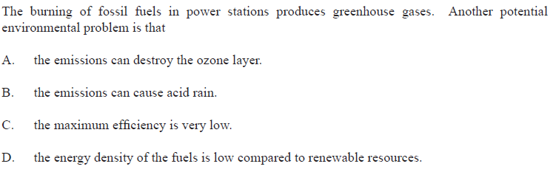
Burning fossil fuels

Slide 27
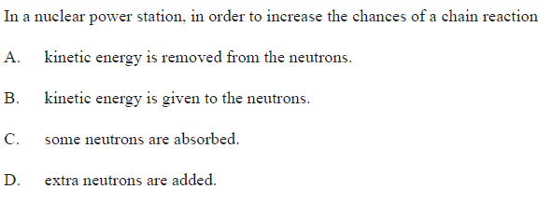
Fission chain reaction

Slide 28
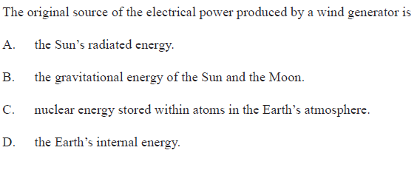
Wind power

Slide 29
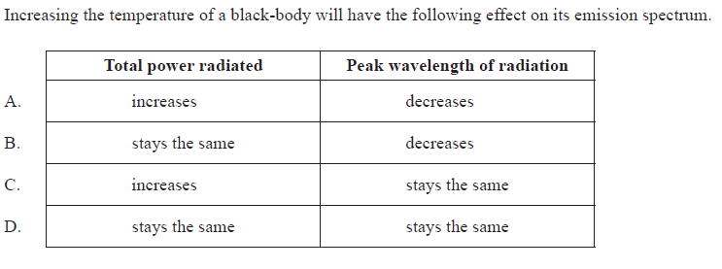
Black body radiation

Slide 30
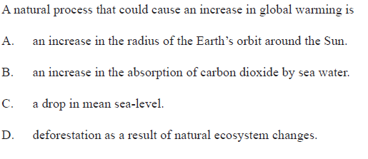
Global warming

Slide 31
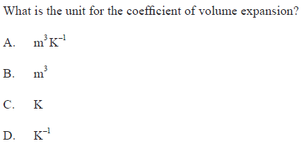
Coefficient of expansion

